Slide 1
Azure Cognitive Services

Slide 2
Azure Cognitive Services
APIs, SDKs, and services available to help developers build intelligent applications
without having direct AI or data science skills or knowledge.
Azure Cognitive Services enable developers to easily add cognitive features – such as
emotion and video detection
facial, speech, and vision recognition
speech and language understanding
into their applications.

Slide 3
Azure Cognitive Services
The goal of Azure Cognitive Services is to help developers create applications that can
see, hear, speak,
understand, and even begin to reason.
The catalog of services within Azure Cognitive Services can be categorized into five categories:
Vision,
Speech,
Language,
Search,
and Knowledge.

Slide 4
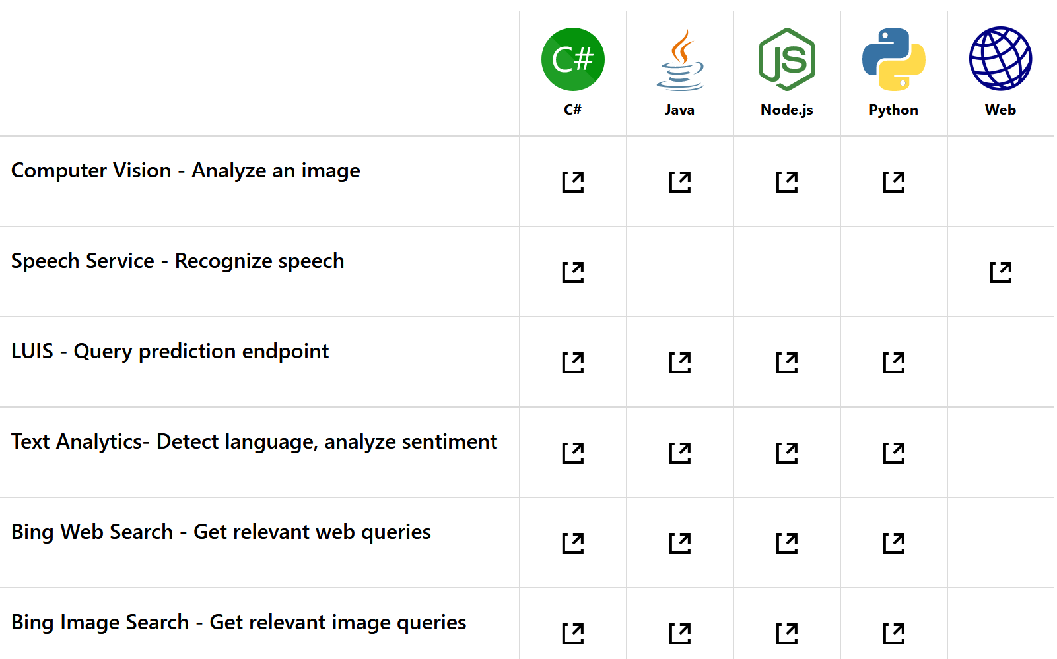
Programming Languages
https://docs.microsoft.com/de-de/azure/cognitive-services/

Slide 5
Azure Cognitive Services
Cognitive Services Homepage
https://azure.microsoft.com/de-de/services/cognitive-services/
https://docs.microsoft.com/en-US/azure/cognitive-services/
Cognitive Services Directory
https://azure.microsoft.com/de-de/services/cognitive-services/directory/
Cognitive Services Documentation
https://docs.microsoft.com/de-de/azure/cognitive-services/

Slide 6
A lot of samples
https://docs.microsoft.com/de-de/azure/cognitive-services/

Slide 7
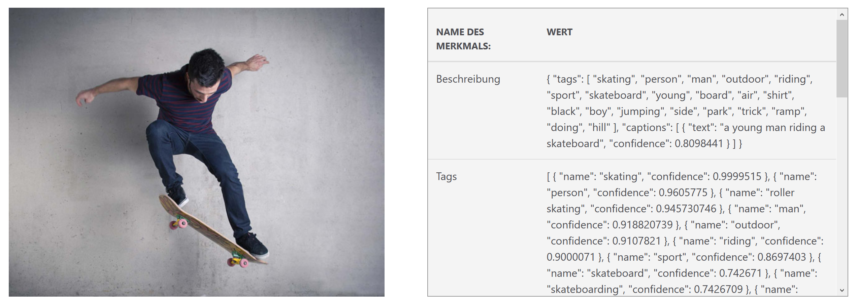
Computer Vision (Analyze Image)
https://azure.microsoft.com/de-de/services/cognitive-services/computer-vision/

Slide 8
Computer Vision (Analyze Image)
REST-API
To use in languages like C#, Node.js and Python
Send a JPG or PNG
Receive contents of photo in JSON-format

Slide 9
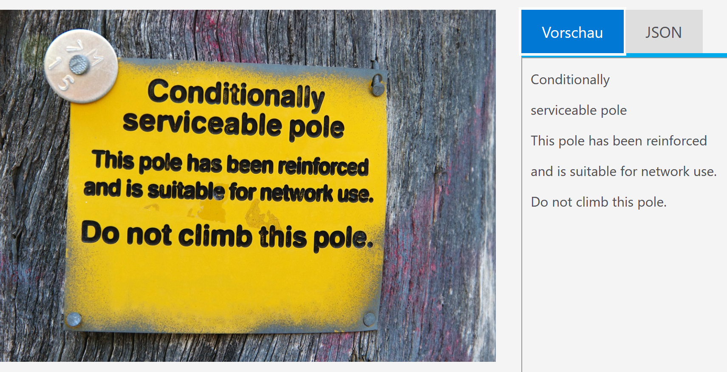
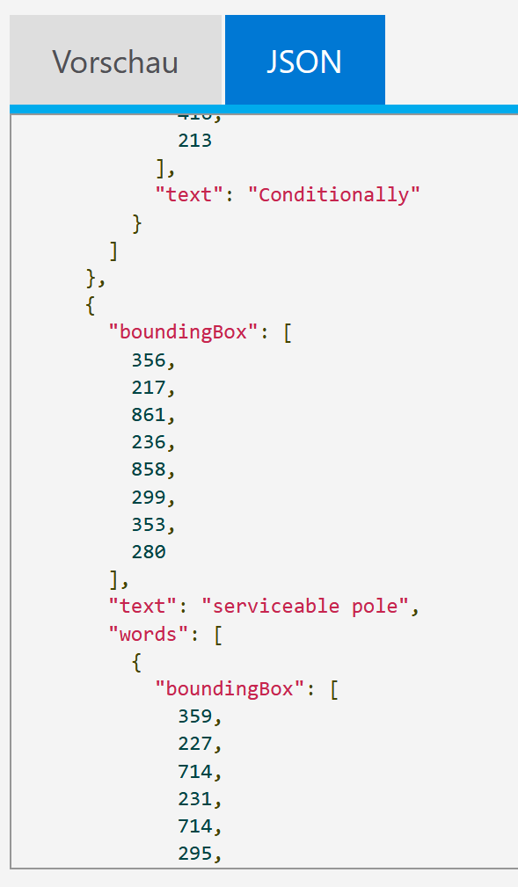
Computer Vision (OCR)

Slide 10
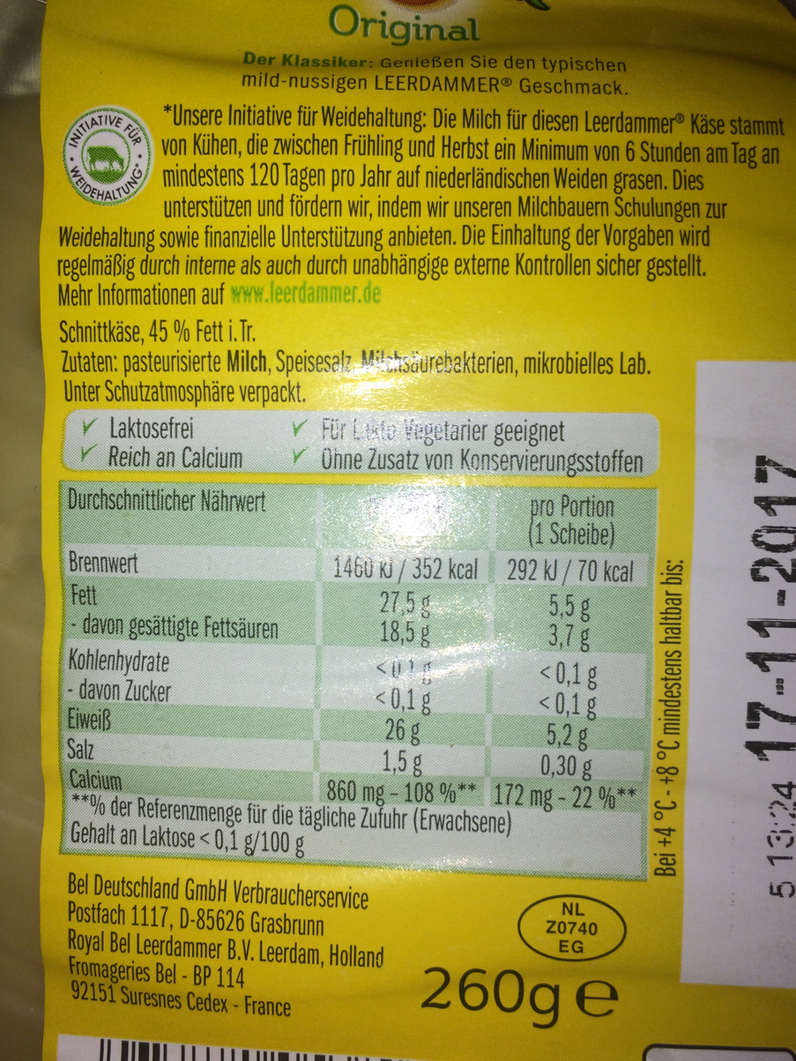
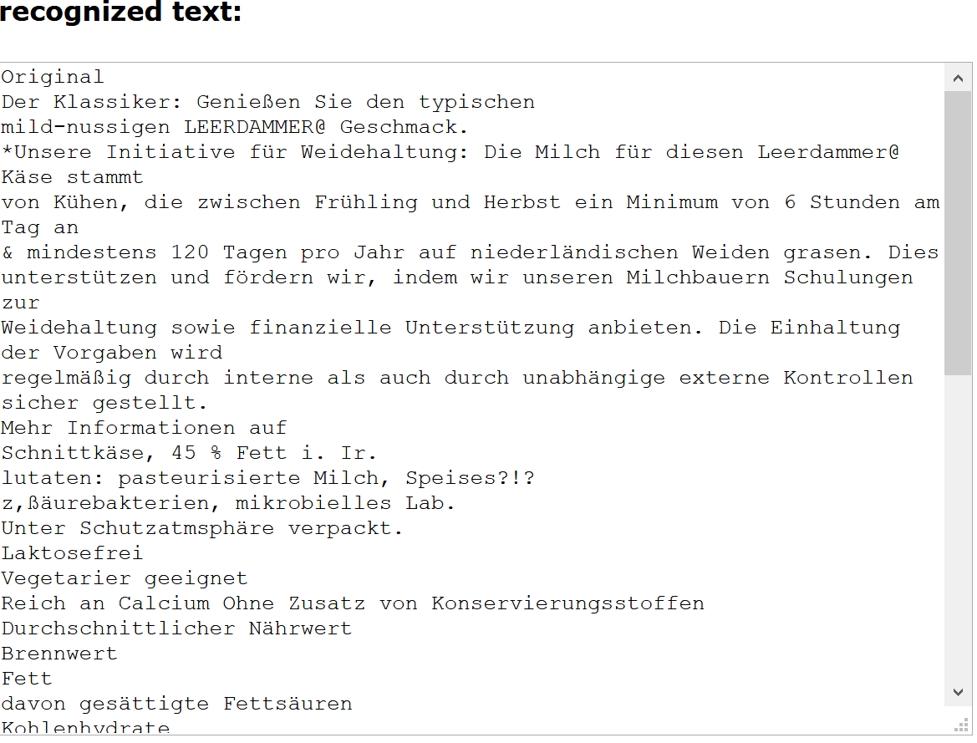
Computer Vision (OCR)

Slide 11
Computer Vision
With the Computer Vision API, you can analyze images to:
Tag images based on content
Categorize images
Identify the type and quality of images
Detect human faces and return their coordinates
Recognize domain-specific content
Generate descriptions of the content
Use optical character recognition to identify printed text found in images
Distinguish color schemes
Flag adult content
Crop photos to be used as thumbnails

Slide 12
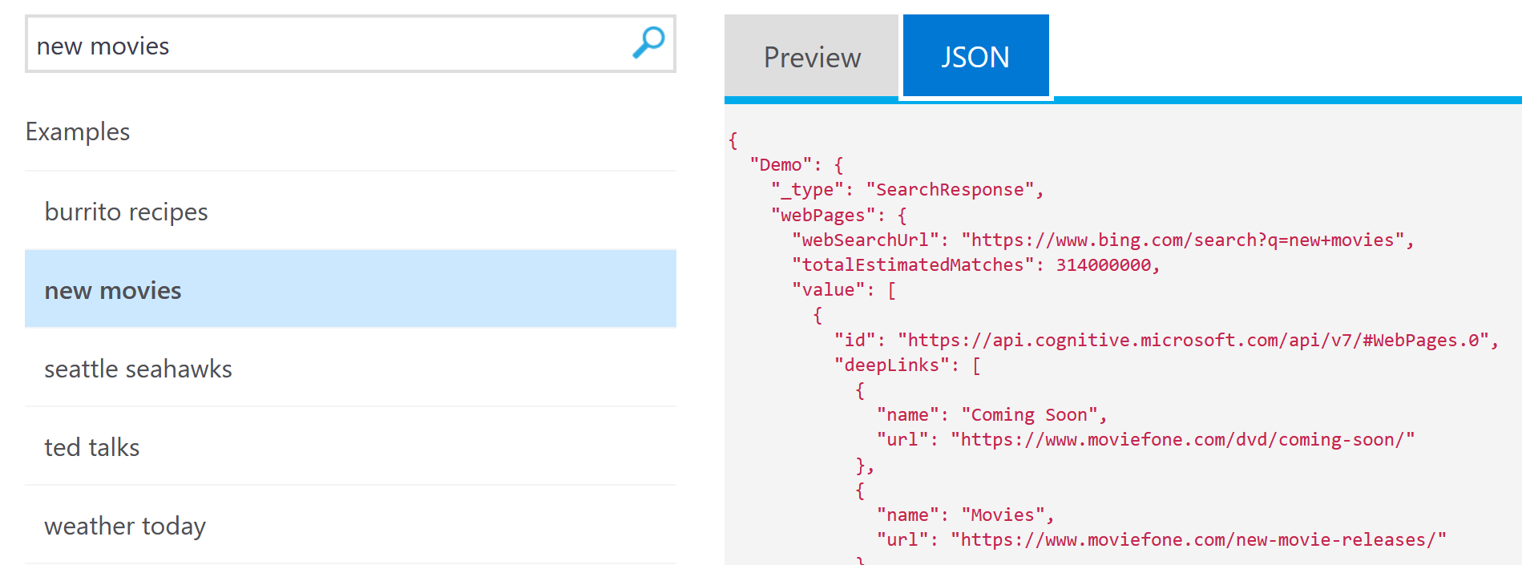
Bing Search
https://azure.microsoft.com/de-de/services/cognitive-services/bing-web-search-api/

Slide 13
Bing Search
Get enhanced search details from billions of web documents
Retrieve web documents indexed by Bing Web Serch API v7
and narrow down the results by result type, freshness and more.
With API v7, discover improved query performance for your results.

Slide 14
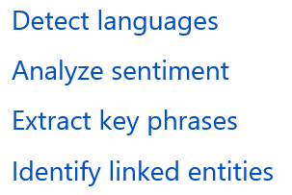
Text Analytics
https://docs.microsoft.com/de-de/azure/cognitive-services/text-analytics/overview

Slide 15

Text Analytics (Sentiments)

Slide 16
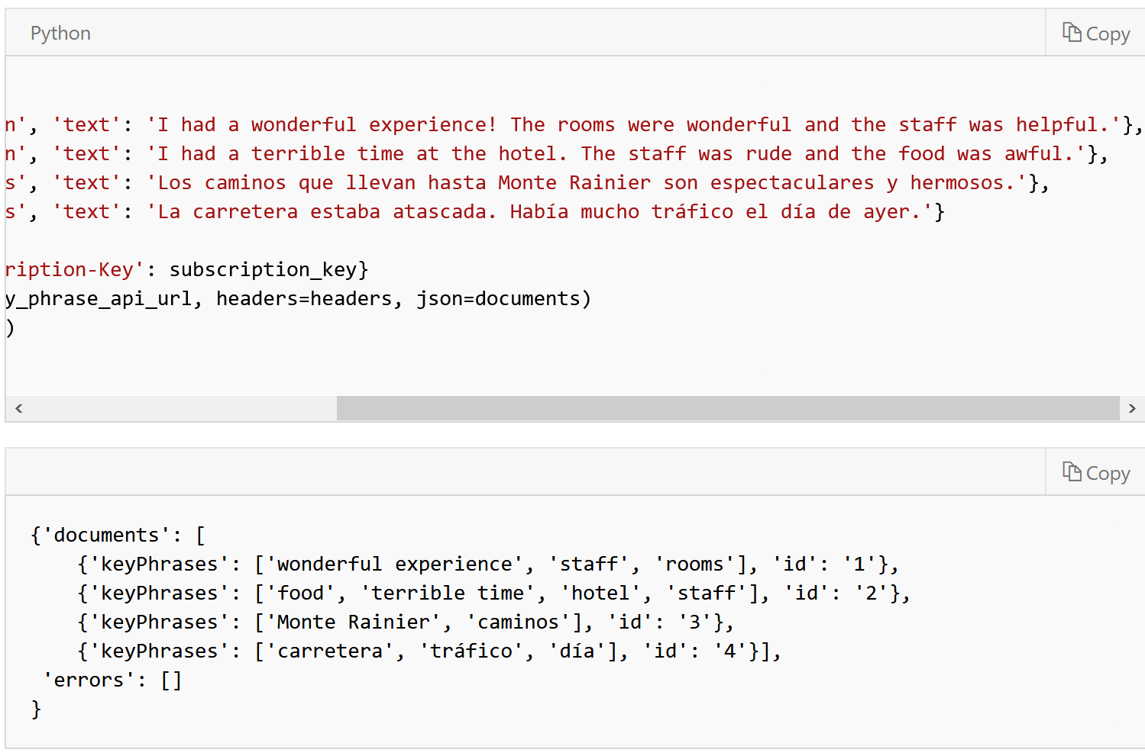
Text Analytics (Key Phrases)

Slide 17
Simple Example for extracting Key Phrases
Text Analytics with PowerBI
https://docs.microsoft.com/de-de/azure/cognitive-services/text-analytics/tutorials/tutorial-power-bi-key-phrases
Quick Start for Text Anlytics with Node.js
https://docs.microsoft.com/de-de/azure/cognitive-services/text-analytics/quickstarts/nodejs

Slide 18
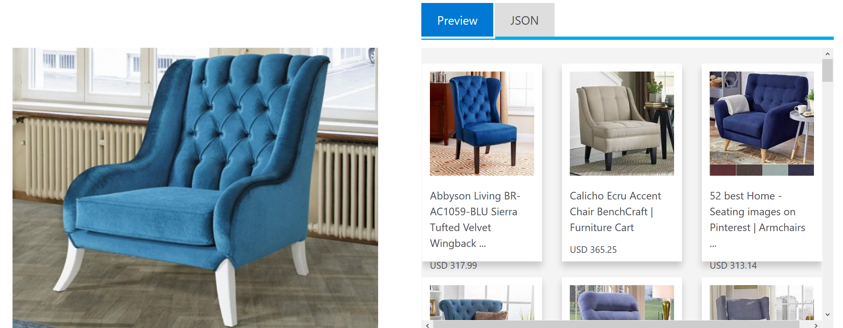
Bing Visual Search API
https://azure.microsoft.com/en-us/services/cognitive-services/bing-visual-search/
https://azure.microsoft.com/en-us/services/cognitive-services/bing-visual-search/

Slide 19
Bing Visual Search API
provides an experience similar to the image details shown on Bing.com/images.
With Visual Search, you can
upload a picture
and get back insights about the image such as visually similar images, shopping sources, webpages that include the image, and more.
Visual Search can identify celebrities, monuments and landmarks, artwork, home furnishings, fashion, products, character recognition (OCR), and more.

Slide 20
Bing Visual Search API
Visual Search lets you discover:
Visually similar images—A list of images that are visually similar to the input image
Visually similar products—A list of images that contain products that are visually similar to the product shown in the input image
Shopping sources—A list of places where you can buy the item shown in the input image
Related searches—A list of related searches made by others or that are based on the contents of the image
Web pages that include the image—A list of webpages that include the input image

